Slide 1
Retention and Development CSI Task Force 5.7 (c) Higher Education Partnerships and New World of Work 21st Century Skills Program
With Support and Interest from
THE CALIFORNIA COMMUNITY COLLEGES CHANCELLOR’S OFFICE “DOING WHAT MATTERS” INITIATIVE
THE FOUNDATION FOR CALIFORNIA COMMUNITY COLLEGES
THE NATIONAL ASSOCIATION FOR COMMUNITY COLLEGE ENTREPRENEURSHIP
THE MOZILLA FOUNDATION
MDRC NATIONAL RESEARCH GROUP
Notes:
Shauna to introduce

Slide 2
Welcome
Jeffrey Mrizek, Consultant, Civil Service Improvement Project
Maureen White, Education Consultant/Specialist, California Community College Chancellor’s Office
Rajinder Gill, Director, New World of Work 21st Century Skills
Shannon Wells, Capital Region Pathway Specialist, Foundation for California Community Colleges
Tim Aldinger, Director of Workforce Development Services, Foundation for California Community Colleges
Notes:
Shannon to lead welcome- 5 minutes, 1:50-1:55 p.m.

Slide 3
Agenda
Retention and Development CSI Task Force 5.7 (c) Higher Education Partnerships
California Community Colleges Task Force on Workforce Job Creation and a Strong Economy
New World of Work 21st Century Skills Program
Foundation for California Community Colleges Services for Recruiters
Notes:
Shannon to review agenda- 5 minutes, 1:55-2 p.m.

Slide 4
Retention and Development CSI Task Force 5.7(c) Higher Education Partnership
Enterprise Competency-based Talent Management Approach &
Statewide Foundational Competency Model
Notes:
Jeff’s presentation; 2-2:20 p.m.

Slide 5
CSI Team Structure
Jeff Douglas CSI Project Manager
Jeffrey Mrizek CSI Team Lead
Guy Burghgraef CalHR Team Consultant
Team Members:
Geoff McLennan
Nathan Parker
Bruce Winner
Indria Gillespie
Steve Linthicum
Tim Aldinger
Martie Goodson
Nancy Thompson
Linda Delgadillo
Dr. Jenni Murphy
Dale van Dam
Shannon Wells
Denise Brandt

Slide 6
Overview
Business case: The “Skills Drain”
Recommendation 1: Adopt an enterprise Competency-Based Talent Management (CBTM) approach.
Recommendation 2: Adopt New World of Work (NWoW)- 21st Century Skills as the enterprise foundational competency model to begin the CBTM implementation.
Next Steps: CSI 5.3 “Operationalizes” enterprise foundational competency model beginning with statewide training.

Slide 7
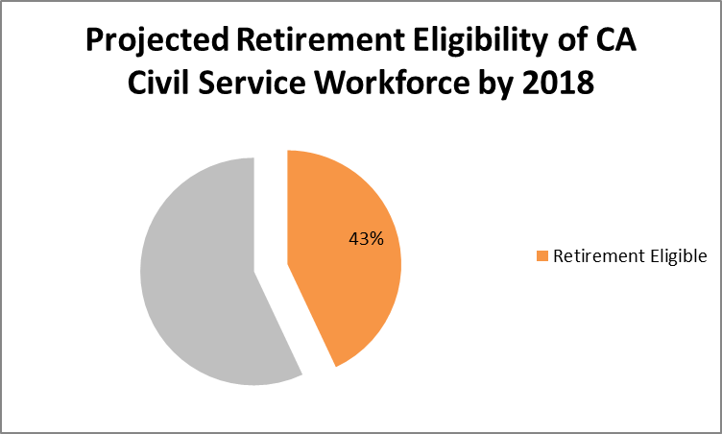
Business Case: The “Skills Drain”
PAIN POINTS:
An inability to clearly identify the talent needed to fill vacancies
Lack of data driven recruitment
Challenges transitioning employees between departments
Lack of unified employee performance accountability in the workplace
Reactive, delayed, and disjointed employment development solutions

Slide 8
RECOMMENDATION 1: Adopt Enterprise Competency-based Talent Management Approach: Provides data driven decision-making to mitigate skills drain
BENEFITS:
Empowers the employee in their career enhancement/upward mobility/professional development.
Provides hiring managers with the ability to filter resumes and identify the HR talent for the job and develop employees with a known skill set. This makes the job transition/onboarding process easier.
Develops state employees with a set of skills they can take with them to other departments.
Provides a quantifiable reportable set of competencies the person has obtained or mastered, rather than assumed mastery of skills based classification alone.
Supports leaning of the project management process by allowing the enterprise to seamlessly facilitate inter- and intra- department transfers to mitigate talent challenges.
Provides the new supervisor with the confidence that their employees are bringing a certain set of skills with them to the new job.
Ensure employees transferring to a new department will be able to take a quantifiable set of skills with them.

Slide 9
RECOMMENDATION 2: Adopt New World of Work (NWoW) Model 21st Century Skills as statewide foundational model
Adaptability
Analysis/Solution Mindset
Collaboration
Communication
Digital Fluency
Empathy
Entrepreneurial Mindset
Resilience
Self-Awareness
Social/Diversity Awareness
Notes:
HANDOUT- Primary Attributes
The project team assessed ten (10) models using both a qualitative and quantitative Criteria-
Alternative Matrix (CAM).
A CAM analysis allows for alternatives to be compared against common
criteria or factors as an efficient way to highlight the best / better alternative and to reduce
subjectivity of the alternatives.
The criteria were:
Affordability
Measurability
Practicality
Adaptability
Inclusivity
Statewide Career Pathways -Vocational Education- SB70
(Chapter 352, Statutes 2005)
Quality Education Investment Act (QEIA) - SB1133
(Chapter 751, Statutes 2006)
Career Pathways Trust - SB1070
“Community Collaboratives”
(Chapter 433, Statutes 2012)
Industry Driven Regional Collaborative (IDRC)
Prop 39 (2012) / SB1402 (Chapter 361, Statutes 2012)
“Workforce Innovation Partnerships (WIP)”
“Industry Sector Skills Panels”
Adult Education Block Grant - AB86
(Chapter 48, Statutes 2013)
Workforce Innovation and Opportunity Act (WIOA) (2014)
From 2012-2014, curriculum tested with over 200 students at FRC
In IDRC pilot project, lessons are being integrated into coursework at 10 partner colleges across the state
Partner colleges participated in Summer 2015 train-the-trainer workshop, co-facilitated with NACCE
As of Fall 2015 term, over 300 students are participating in the 21st Century Skills project, half of them in workplace learning placements
Courses using 21st Century Skills represent a range of industry sectors
Future funding could grow number of colleges utilizing the skills curriculum & digital badges
Columbia College
Feather River College
Folsom Lake College
Hartnell College
Lassen College
Santa Barbara City College
Santa Rosa Junior College
Shasta College
SCBC Miramar
West Hills Coalinga
New World of Work- 21ST CENTURY SKILLS
PRIMARY ATTRIBUTES
ADAPTABILITY
• Aware of and positively responds to change.
• Has a flexible approach to work, which includes various work environments, roles, tasks, and ideas.
• Takes into account diverse viewpoints and input to achieve work outcomes.
• Handles stress, setbacks, and constructive criticism with healthy coping mechanisms in order to learn
from experience and continue to move forward.
ANALYSIS_SOLUTION MINDSET
• Considers multiple points of view and analyzes motivations behind multiple sources of information.
• Recognizes problems and needs within a societal, community, or workplace context in order to
develop solutions.
• Examines information broadly, analyzes data, and utilizes critical thinking.
• Develops multiple solutions using hypotheses/ trial and error to test and determine effectiveness.
COLLABORATION
• Builds and maintains mutually beneficial relationships by working collaboratively with diverse groups or teams.
• Incorporates a range of perspectives and cultural norms while reinforcing common ground and shared goals.
• Applies a transformational leadership approach where one seeks input, incorporates feedback, implements
new ideas, offers help, and engages all team members.
• Handles conflict constructively and views failure as an opportunity to learn.
COMMUNICATION
• Presents information that is appropriate in content, professional in both tone and language, and tailored
to the recipient/audience.
• Uses digital media, social media, and other technology communication tools properly for work settings.
• Understands basic etiquette and rules in non-verbal, verbal, and written communication to e_ectively and
accurately convey meaning.
• Uses attentive listening skills, which includes asking clarifying questions and summarizing information back
to check for understanding.
DIGITAL FLUENCY
• Understands the appropriate technology tools to work collaboratively in person and remotely.
• Has basic knowledge of the ethical and legal issues related to information technology and shares information
accordingly.
• Understands how to use technology tools including computer components and functions (keyboard, mouse
pad, browser windows, email).
• Uses online tools including search engines to gather research and data as well as solve problems.
ENTREPRENEURIAL MINDSET
• Self-motivated and strives for professional development by seeking new knowledge, training,
and responsibilities.
• Focuses on brainstorming, innovation, and new ideas while connecting information from various sources.
• Takes risks, learns from mistakes, and is driven to complete tasks in order to develop new or improved
products, services, or processes.
• Entrepreneur or intraprenuer with the ability to work independently or in teams while being mindful
of client/customer needs.
EMPATHY
• Knows the difference between empathy and sympathy and when to apply each given the situation.
• Actively uses skills to build empathy including: active listening, honest communication to establish trust,
open-ended questions, mirroring, and checking for understanding.
• Builds relationships through understanding and valuing diverse backgrounds and cultures.
• Connects with clients/customers by thinking about their needs and points of view, making decisions based
on those needs, and continually evaluating client/customer satisfaction.
RESILIENCE
• Sets goals, prioritizes, and anticipates possible consequences of decisions in order to make back up plans.
• Handles setbacks positively by reflecting on experience, learning from mistakes, and using this information
to inform future decisions.
• Openness to others' viewpoints and ability to voice one's own opinion in order to synthesize feedback
and resolve conflicts.
• Has a growth mindset: seeks new knowledge and skills to expand learning and commits to learning as
a lifelong process.
SELF-AWARENESS
• Accurately assesses own personality, strengths, and areas of growth seeking ways to continually develop skills.
• Displays personal responsibility combined with social awareness by maintaining self-control and ethical
behavior.
• Cultivates professionalism by being consistent, following required guidelines and rules, and maintaining
appropriate dress and communication.
• Maintains an awareness of preferences for types of work and environments to capitalize on strengths.
SOCIAL/DIVERSITY AWARENESS
• Demonstrates sensitivity and respect toward others with diverse backgrounds and cultures both locally
and globally.
• Values and embraces diversity in the workplace including gender, sexual orientation, ethnicity, and age.
• Leverages social and cultural differences to redefine social norms and generate new ideas.
• Uses professionalism and interpersonal skills to establish rewarding relationships with diverse individuals
and groups.

Slide 10
NWoW Integrated into Competency Based Talent Management Approach

Slide 11
NEXT STEPS: CSI 5.3 Operationalizes Foundational Model in Training first using an “In and Up” Strategy

Slide 12
IN
UP
Competency Based Public to Public Career Pathways:
A Structural Coupling Model
Community Colleges
Civil Service
Departments
Shared HRIS Competency
Data/Digital Badges
P2P Pathways

Slide 13
Maureen White, Ed.D., SHRM-SCP - Workforce Division, CCCCO
#StrongWorkforce
@CalCommColleges @WorkforceVan
www.DoingWhatMATTERS.cccco.edu
Notes:
Maureen’s presentation, 2:20-2:30 p.m.

Slide 14
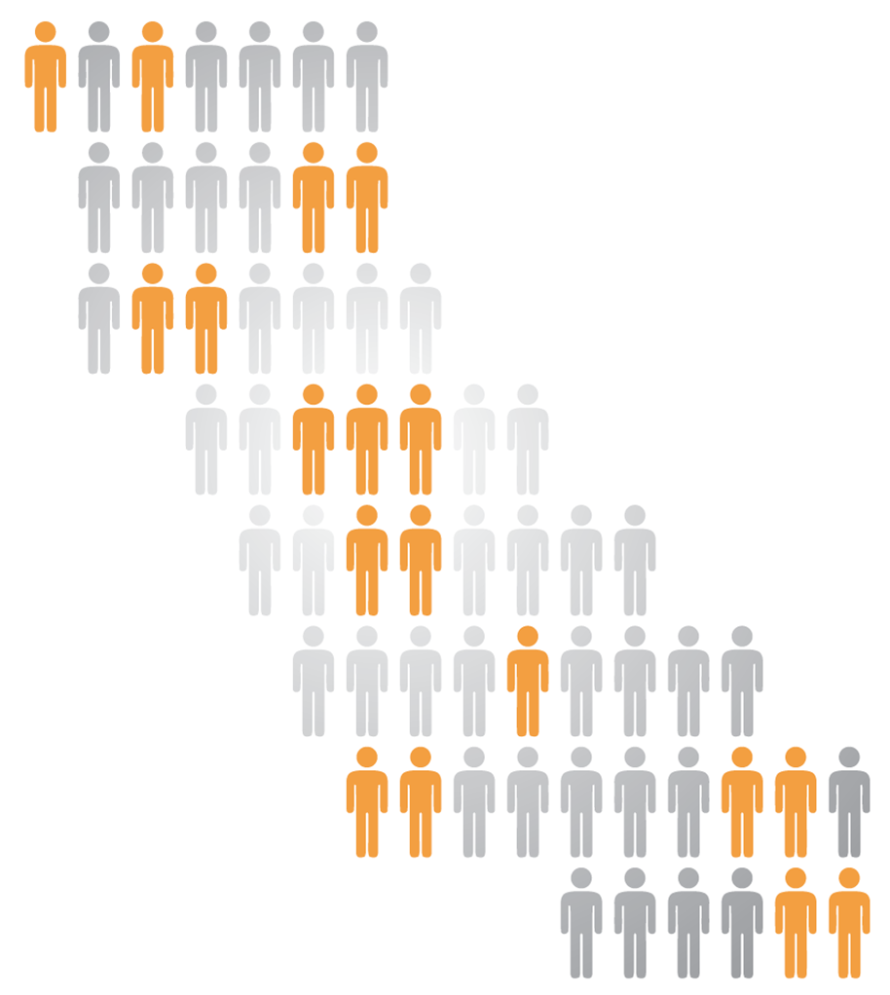
Task Force Roll Out
#StrongWorkforce
14 Regional College & Faculty Conversations
Over 700 attendees, including 40% faculty
6 Strong Workforce Town Hall Meetings
Over 500 participants in regions across the state
6 expert background papers on common themes
Workforce Data & Outcomes
Curriculum Development & Instructors
Structured Pathways and Student Support (2 parts)
Regional Coordination
Funding
5 meetings of the 26-member Task Force
221 website & 10 letters during public comment period
Notes:
-14 Regional College & Faculty Conversations
-5 Town Hall meetings with external stakeholders
- With goal of making recommendations to the Board of Governors in September this year

Slide 15
7 Key Recommendations
Student Success
Workforce Data & Outcomes
Curriculum
Career Pathways
CTE Faculty
Regional Coordination
Funding

Slide 16
7 Key Recommendations
Through a series of college and faculty meetings, a number of town hall meetings and extensive research, the task force developed a comprehensive plan comprised of the 25 recommendations focusing on seven broad areas:
Student Success: Removing barriers to education completion with improved career exploration and planning, work-based learning and other support.
Career Pathways: Putting industry at the forefront of career pathway development with clear, defined sequences for learning industry-valued skills.
Workforce Data & Outcomes: Continuous program improvement based on robust metrics and outcome data.

Slide 17
7 Key Recommendations
.
Curriculum: Streamlining the curriculum-approval process. Currently, it takes too long, leaving students without timely skills employers
CTE Faculty: Increasing the pool of qualified Career Technical Education (CTE) faculty. Currently, it's difficult to attract quality faculty because of education requirements and salary differentials.
Regional Coordination to pool resources and efforts for CTE and responding to industry needs.
Funding: Establishing a dedicated and sustainable funding source for CTE programs. Currently, CTE courses are funded at the same level as general education courses. Yet, they have higher startup and operating costs. Funding gaps are closed with grants, but those are not long-term solutions.
To read the full set of recommendations, please go to http://bit.ly/1IpCGOM

Slide 18
Stay Connected
www.DoingWhatMATTERS.cccco.edu/StrongWorkforce.aspx
#StrongWorkforce
@CalCommColleges @WorkforceVan

Slide 19
#StrongWorkforce
Notes:
<Thank JP Morgan Chase & Chancellor’s Circle>

Slide 20
New World of Work 21st Century Skills Program
Started in 2012 through New World of Work Initiative, funded through CCCCO
Skills Panels, career research, and socioeconomic futuring informed “Top 10” necessary 21st Century Skills list
Overview video:
https://www.youtube.com/watch?v=S-Kmt4Uyutc
Notes:
Rajinder’s presentation, 2:30-2:45

Slide 21
Pilot Project: Modules
2 modules per skill, target audience 2yr/4yr college students, adult learners, & current members of the workforce
Each module has a lesson plan, presentation, a “what not to do” video teaser or longer video assessment, and handouts
Hosted at www.newworldofwork.org
Modules can be used in workshops/trainings, integrated into coursework, used to create new classes, ideally in tandem with workplace learning
Current integration across 10 partner colleges through Fall 2016 with curriculum, data collection, assessments, and digital badging

Slide 22
Pilot Project: Partner Colleges
From 2012-2014, curriculum tested with over 200 students at FRC
In IDRC pilot project, lessons are being integrated into coursework at 10 partner colleges across the state
Partner colleges participated in Summer 2015 train-the-trainer workshop, co-facilitated with NACCE
In the Fall 2015 term, over 300 students participated in the 21st Century Skills courses, half of them in workplace learning placements & over 150 participated in workshops
Courses using 21st Century Skills represent a range of Industry Sectors
Future funding could grow number of colleges utilizing the skills curriculum & digital badges

Slide 23
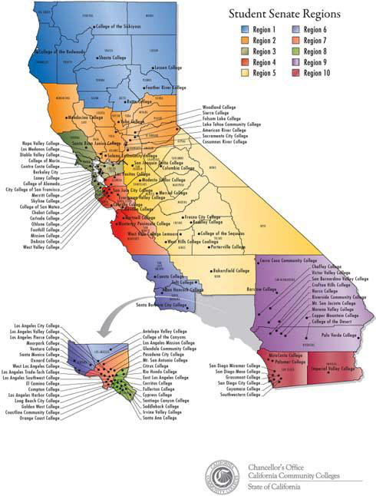
Partner Colleges in CA
Columbia College
Feather River College
Folsom Lake College
Hartnell College
Lassen College
Santa Barbara City College
Santa Rosa Junior College
Shasta College
SCBC Miramar
West Hills Coalinga

Slide 24
Courses implementing 21st Century Skills Curriculum
Folsom Lake College
Work Experience (WEX)
Feather River College
Business
Hartnell
Electrical and Electronic System
Lassen
Human Services
Career/Employment Strategies
Administration of Justice WEX
Health Occupations WEX
Business WEX
WEX
Columbia College
-- Workshops for Ag, Enviro. Tech, & Transportation Dept. students
Southern California Biotech Center at Miramar College
Biotechnology
Santa Barbara City College
Entrepreneurship
Santa Rosa Junior College
Soft Skills for Business
Shasta College
Civic and Community Engagement
West Hills Coalinga
Anatomy for Nurses

Slide 25
Pilot Project: Data & Assessments
Data tracking: students and courses utilizing NWoW 21st Century Skills
Assessments: instructor feedback on lessons, student self-assessments, & employer assessments of students to track skill growth
Assessments based on the Primary Attributes List
Researched and established through collaboration with the Foundation for CA Community Colleges and the Mozilla Foundation
MDRC National Research Group is conducting a third party review of assessments

Slide 26
Pilot Project: Digital Badges
NWoW partnering with the Foundation for California Community Colleges to create ten 21st Century Skills badges
Badges will be hosted through the Foundation’s LaunchPath site www.launchpath.com
Digital badges will be “micro-credentials” showing verification of skills
Using Mozilla Open Badge Eco-system to allow public recognition of badges on LinkedIn, FB, websites, etc.
Notes:
Shannon’s presentation, 2:45-2:50 p.m.

Slide 27
Pilot Project: Digital Badges
Assessment developer currently utilizing Badging Advisory Group feedback, input from partner groups like Mozilla & IMS Global, 21st Century Skills curriculum, and Primary Attributes List to create badging assessments
Foundation team will have platform built & assist in leading badging training by Summer 2016
Badges will be tied to completion of 21st Century Skills coursework and in part vetted by instructors
Modified versions of badges could be used to verify if employees have specific core skills, “pre-screening”

Slide 28
Foundation for California Community Colleges Services for Recruiters
Career Catalyst (Career Pathway)
Suite of services for those seeking to hire students for jobs or paid internships. Foundation assumes liability and performs human resources and payroll functions.
Participating State Agencies:
Agricultural Labor Relations Board
Air Resources Board
California Department of Technology
Department of Resources Recycling and Recovery (CalRecycle)
California Community Colleges Chancellor’s Office
Department of Parks and Recreation, Division of Boating and Waterways
Governor’s Office of Emergency Services
Public Service Rotation Program
Proposed partnership to coordinate short-term student employment in state government agencies throughout California
Notes:
Tim’s presentation, 2:50-3 p.m.

Slide 29
Thank you!
Jeffrey Mrizek, Consultant, Civil Service Improvement Project, jeff.mrizek@calhr.ca.gov
Maureen White, Education Consultant/Specialist, California Community College Chancellor’s Office, mwhite@cccco.edu
Rajinder Gill, New World of Work 21st Century Skills Director, rgill@frc.edu
Shannon Wells, Capital Region Pathway Specialist, Foundation for California Community Colleges, swells@foundationccc.org
Tim Aldinger, Director of Workforce Development Services, Foundation for California Community Colleges, taldinger@foundationccc.org
Notes:
Q&A, 3-3:15

